Slide 1

Presentation By,
Sharath M M

Slide 2

What is GPU?
It is a processor optimized for 2D/3D graphics, video, visual computing, and display.
It is highly parallel, highly multithreaded multiprocessor optimized for visual computing.
It provide real-time visual interaction with computed objects via graphics images, and video.
It serves as both a programmable graphics processor and a scalable parallel computing platform.
Heterogeneous Systems: combine a GPU with a CPU

Slide 3

1980’s – No GPU. PC used VGA controller
1990’s – Add more function into VGA controller
1997 – 3D acceleration functions:
Hardware for triangle setup and rasterization
Texture mapping
Shading
2000 – A single chip graphics processor ( beginning of GPU
term)
2005 – Massively parallel programmable processors
2007 – CUDA (Compute Unified Device Architecture)

Slide 4

OpenGL – an open standard for 3D programming
DirectX – a series of Microsoft multimedia programming interfaces
New GPU are being developed every 12 to 18 months
New idea of visual computing:
combines graphics processing and parallel computing
Heterogeneous System – CPU + GPU
GPU evolves into scalable parallel processor
GPU Computing: GPGPU and CUDA
GPU unifies graphics and computing
GPU visual computing application: OpenGL, and DirectX

Slide 5

CPU-GPU system architecture
– The Historical PC
– contemporary PC with Intel and AMD CPUs
Graphics Logical Pipeline
Basic Unified GPU Architecture

Slide 6

A GPU is tailored for highly parallel operation while a CPU executes programs serially
For this reason, GPUs have many parallel execution units and higher transistor counts, while CPUs have few execution units and higher clockspeeds
A GPU is for the most part deterministic in its operation (though this is quickly changing)
GPUs have much deeper pipelines (several thousand stages vs 10-20 for CPUs)
GPUs have significantly faster and more advanced memory interfaces as they need to shift around a lot more data than CPUs

Slide 7

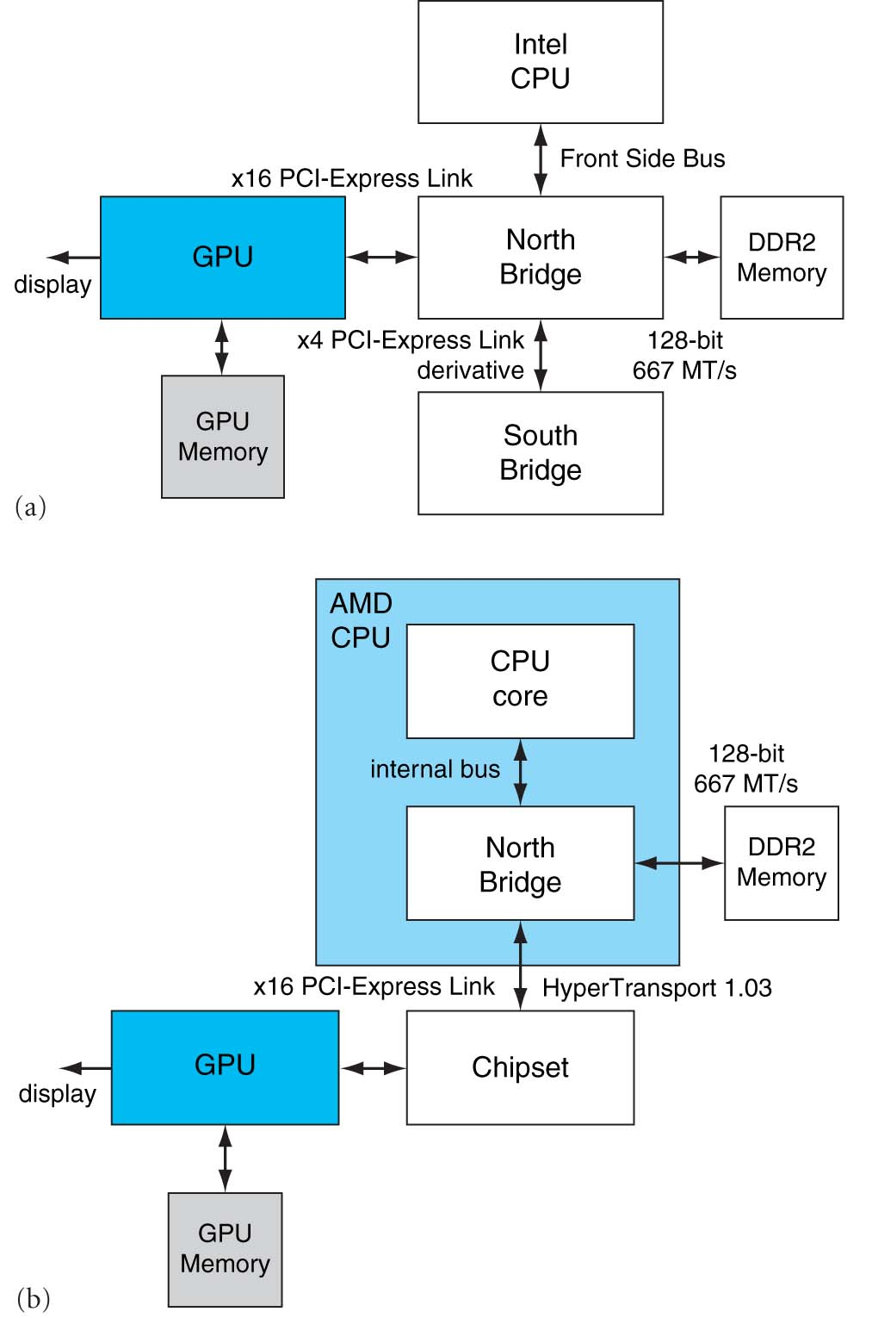
FIGURE A.2.2 Contemporary PCs with Intel and AMD CPUs. See Chapter 6 for an explanation of the components and interconnects in this figure. Copyright © 2009 Elsevier

Slide 8

The GPU receives geometry information from the CPU as an input and provides a picture as an output
Let’s see how that happens
host
interface
vertex
processing
triangle
setup
pixel
processing
memory
interface

Slide 9

The host interface is the communication bridge between the CPU and the GPU
It receives commands from the CPU and also pulls geometry information from system memory
It outputs a stream of vertices in object space with all their associated information (normals, texture coordinates, per vertex color etc)
host
interface
vertex
processing
triangle
setup
pixel
processing
memory
interface

Slide 10

The vertex processing stage receives vertices from the host interface in object space and outputs them in screen space
This may be a simple linear transformation, or a complex operation involving morphing effects
Normals, texcoords etc are also transformed
No new vertices are created in this stage, and no vertices are discarded (input/output has 1:1 mapping)
host
interface
vertex
processing
triangle
setup
pixel
processing
memory
interface

Slide 11

In this stage geometry information becomes raster information (screen space geometry is the input, pixels are the output)
Prior to rasterization, triangles that are backfacing or are located outside the viewing frustrum are rejected
Some GPUs also do some hidden surface removal at this stage
host
interface
vertex
processing
triangle
setup
pixel
processing
memory
interface

Slide 12

A fragment is generated if and only if its center is inside the triangle
Every fragment generated has its attributes computed to be the perspective correct interpolation of the three vertices that make up the triangle
host
interface
vertex
processing
triangle
setup
pixel
processing
memory
interface

Slide 13

Each fragment provided by triangle setup is fed into fragment processing as a set of attributes (position, normal, texcoord etc), which are used to compute the final color for this pixel
The computations taking place here include texture mapping and math operations
Typically the bottleneck in modern applications
host
interface
vertex
processing
triangle
setup
pixel
processing
memory
interface

Slide 14

Fragment colors provided by the previous stage are written to the framebuffer
Used to be the biggest bottleneck before fragment processing took over
Before the final write occurs, some fragments are rejected by the zbuffer, stencil and alpha tests
On modern GPUs, z and color are compressed to reduce framebuffer bandwidth (but not size)
host
interface
vertex
processing
triangle
setup
pixel
processing
memory
interface

Slide 15

Vertex and fragment processing, and now triangle set-up, are programmable
The programmer can write programs that are executed for every vertex as well as for every fragment
This allows fully customizable geometry and shading effects that go well beyond the generic look and feel of older 3D applications
host
interface
vertex
processing
triangle
setup
pixel
processing
memory
interface

Slide 16

Input from CPU
Host interface
Vertex processing
Triangle setup
Pixel processing
Memory Interface
64bits to
memory
64bits to
memory
64bits to
memory
64bits to
memory

Slide 17

Nemo-3D
Written by the CalTech Jet Propulsion Laboratory
NEMO-3D simulates quantum phenomena.
These models require a lot of matrix operations on very large matrices.
We are modifying the matrix operation functions so they use CUDA instead of that slow CPU.

Slide 18


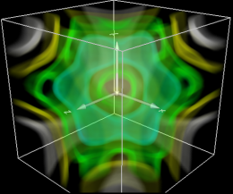
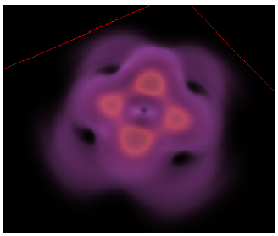
Simulation
Visualization
NEMO-3D
VolQD
Computation
Module
CUDA
kernel

Slide 19

This leads to a number of synchronization considerations
In the figure below, the CPU must not overwrite the data in the “yellow” block until the GPU is done with the “black” command, which references that data:
GPU reads commands from here
CPU writes commands here
data

Slide 20

Modern APIs implement semaphore style operations to keep this from causing problems
If the CPU attempts to modify a piece of data that is being referenced by a pending GPU command, it will have to spin around waiting, until the GPU is finished with that command
While this ensures correct operation it is not good for performance since there are a million other things we’d rather do with the CPU instead of spinning
The GPU will also drain a big part of the command buffer thereby reducing its ability to run in parallel with the CPU

Slide 21

One way to avoid these problems is to inline all data to the command buffer and avoid references to separate data:
However, this is also bad for performance, since we may need to copy several Mbytes of data instead of merely passing around a pointer
GPU reads commands from here
data
CPU writes commands here

Slide 22

A better solution is to allocate a new data block and initialize that one instead, the old block will be deleted once the GPU is done with it
Modern APIs do this automatically, provided you initialize the entire block (if you only change a part of the block, renaming cannot occur)
Better yet, allocate all your data at startup and don’t change them for the duration of execution (not always possible, however)
data
data
data
data

Slide 23

The output of a GPU is a rendered image on the screen, what will happen if the CPU tries to read it?
The GPU must be syncronized with the CPU, ie it must drain its entire command buffer, and the CPU must wait while this happens
GPU reads commands from here
Pending GPU commands
CPU writes commands here

Slide 24

We lose all parallelism, since first the CPU waits for the GPU, then the GPU waits for the CPU (because the command buffer has been drained)
Both CPU and GPU performance take a nosedive
Bottom line: the image the GPU produces is for your eyes, not for the CPU (treat the CPU -> GPU highway as a one way street)

Slide 25

Since the GPU is highly parallel and deeply pipelined, try to dispatch large batches with each drawing call
Sending just one triangle at a time will not occupy all of the GPU’s several vertex/pixel processors, nor will it fill its deep pipelines
Since all GPUs today use the zbuffer algorithm to do hidden surface removal, rendering objects front-to-back is faster than back-to-front (painters algorithm), or random ordering
Of course, there is no point in front-to-back sorting if you are already CPU limited

Slide 26

ANY QUESTIONS

